Slide 1
Comparison of Crowd Counting Strategies for Images with Similar Backgrounds
Isaac Pittman, Samuel Bouchard, Joseph Benedict
May 1, 2018

Slide 2
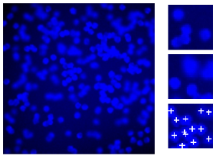
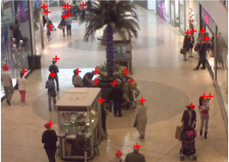
Introduction
Counting objects by hand is time-consuming and prone to human error
Want to implement solution using basic machine learning techniques
Bare minimum annotations desirable
http://www.robots.ox.ac.uk/~vgg/research/counting/index_org.html http://personal.ie.cuhk.edu.hk/~ccloy/downloads_mall_dataset.html

Slide 3
Our Approach – Feature Extraction
First approach (Pixels as Features)
Hilbert curve to reduce dimensionality
Preserves locality of pixel clusters
Second approach (Visual Bag of Words)
VLFeat to extract 128-dimensionl SIFT descriptors
K-means clustering
Find the nearest descriptor to each cluster’s center

Slide 4
Our Approach - Training
Compare the results of each feature extraction method
Linear Regression
Gradient Descent
With and without L2 regularization

Slide 5
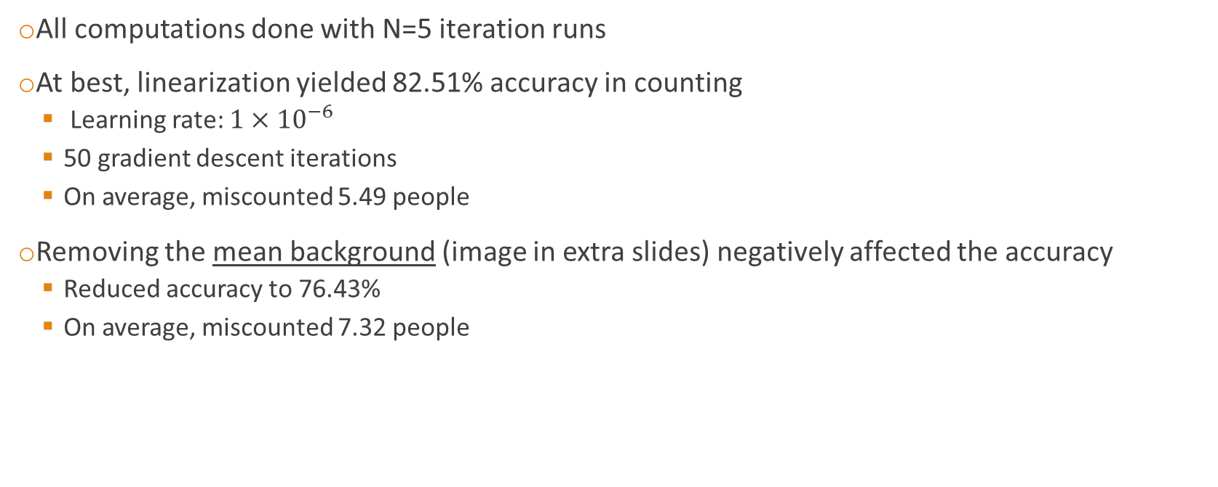
Results – Pixels as Features
All computations done with N=5 iteration runs
At best, linearization yielded 82.51% accuracy in counting
Learning rate: $1×{10}^{−6}$
50 gradient descent iterations
On average, miscounted 5.49 people
Removing the mean background (image in extra slides) negatively affected the accuracy
Reduced accuracy to 76.43%
On average, miscounted 7.32 people

Slide 6
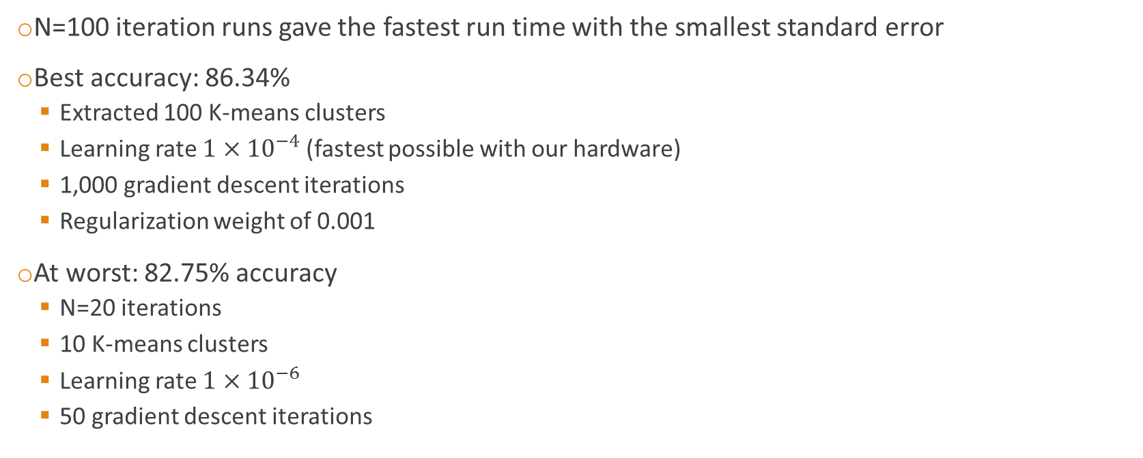
Results – Visual Bag of Words
N=100 iteration runs gave the fastest run time with the smallest standard error
Best accuracy: 86.34%
Extracted 100 K-means clusters
Learning rate $1×{10}^{−4}$ (fastest possible with our hardware)
1,000 gradient descent iterations
Regularization weight of 0.001
At worst: 82.75% accuracy
N=20 iterations
10 K-means clusters
Learning rate $1×{10}^{−6}$
50 gradient descent iterations

Slide 7
Conclusion
Using the simplest implementation of linear regression with Pixels as Features gave reasonably good accuracy
Computationally Expensive (i.e. Slow)
Visual Bag of Words performed better than Pixels as Features
Fewer features
Greater learning rate and more iterations of gradient descent

Slide 8
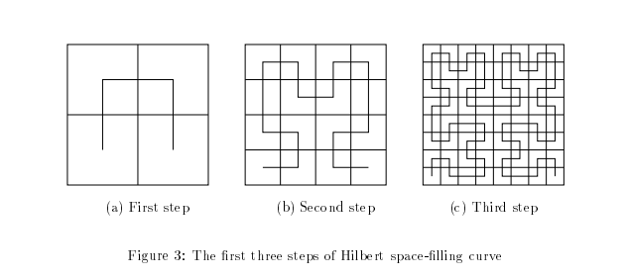
Extra Slide -Hilbert Curve
Linearizes feature space
Preserves clusters in linear space
Moon et al. 2001

Slide 9
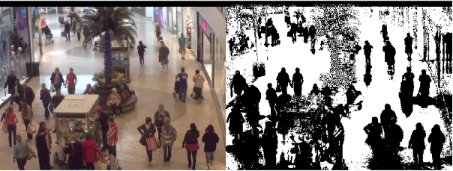
Extra Slide – Background Removal

Slide 10
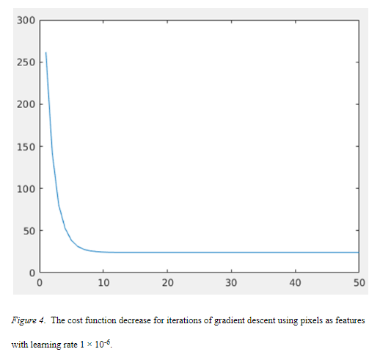
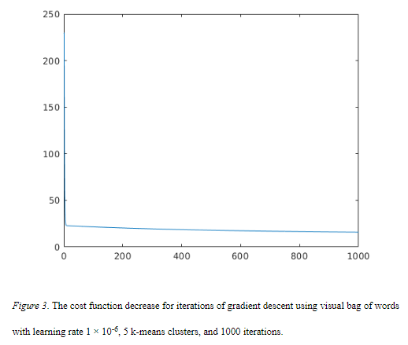
Extra Slide – Cost Functions

